Slide 1
Smart Plant Care System

Slide 2
Introduction
Objective
To develop an IoT-based system for monitoring and logging environmental conditions to enhance plant care.
Features:
Monitors Temperature, Humidity, and Soil Moisture.
Displays real-time data on an LCD.
Logs data to an SD Card.
Sends data to an IoT platform (ThingSpeak) for remote monitoring.

Slide 3
System Components
Microcontroller:
ESP32 (WiFi-enabled microcontroller for IoT applications).
Sensors:
DHT22 for measuring Temperature and Humidity.
Soil Moisture Sensor for detecting soil moisture levels.
Storage:
SD Card Module for logging data locally.
Display:
LCD 20x4 I2C for displaying real-time data.
IoT Platform:
ThingSpeak for remote data monitoring.

Slide 4
System Architecture
Diagram: Include a block diagram showing how the components interact:
Sensors collect data → ESP32 processes it → Data is displayed, logged, and sent to ThingSpeak.

Slide 5
Features
Real-time Monitoring:
Displays Temperature, Humidity, and Soil Moisture on an LCD screen.
Data Logging:
Logs data on an SD card for future analysis.
IoT Integration:
Sends real-time data to ThingSpeak for remote monitoring.
Error Handling:
Displays error messages on the LCD when sensors or SD card fail.

Slide 6
How It Works
Startup:
The system initializes the WiFi connection, DHT22 sensor, and SD card.
Data Collection:
Reads temperature and humidity from DHT22.
Reads soil moisture level using the soil moisture sensor.
Data Display:
Displays the collected data on the LCD screen.
Data Logging:
Logs the data in a file on the SD card (data.csv).
IoT Communication:
Sends the data to ThingSpeak for remote viewing.

Slide 7
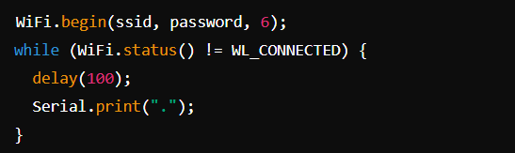

Key Code Features
WiFi Connectivity:
Sensor Reading:

Slide 8
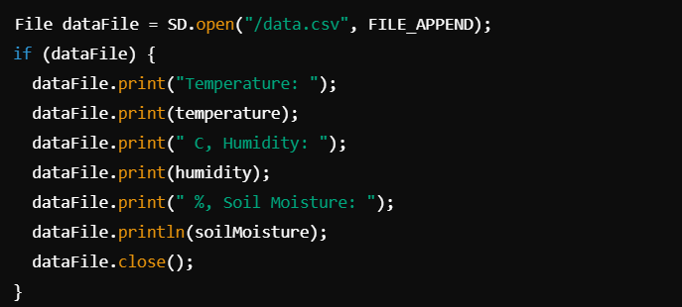
Key Code Features
Data Logging:

Slide 9
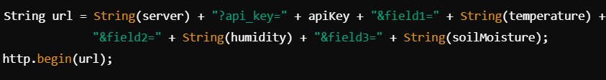
Key Code Features
IOT:

Slide 10
Benefits
Automated monitoring reduces manual intervention.
IoT integration enables remote monitoring from anywhere.
Cost-effective and scalable for home gardens and farms.
Data logging provides historical insights for better decision-making.

Slide 11
Challenges
Sensor Accuracy: Sensors may require calibration for optimal performance.
WiFi Dependency: Requires stable internet connectivity for ThingSpeak.
Power Supply: Continuous monitoring requires a reliable power source.

Slide 12
Conclusion
Smart and Efficient Solution for Plant Care:
This system automates the process of monitoring crucial environmental factors such as temperature, humidity, and soil moisture. It eliminates the need for manual checks, making plant care easier, more efficient, and reliable.
Real-Time Monitoring:
The system displays real-time data on an LCD screen, allowing users to see the current conditions of their plants instantly. This helps in making quick decisions to maintain optimal plant health.

Slide 13
Conclusion
Data Logging:
By storing the environmental data on an SD card, the system enables users to track historical trends. This information can be used for analysis, such as understanding how weather changes affect plant growth or identifying patterns that lead to better plant care.
IoT Connectivity:
Through integration with the ThingSpeak IoT platform, users can access the plant data remotely from anywhere with internet connectivity. This feature is particularly useful for those who cannot be physically present to monitor their plants, ensuring they stay informed at all times.

